Slide 1
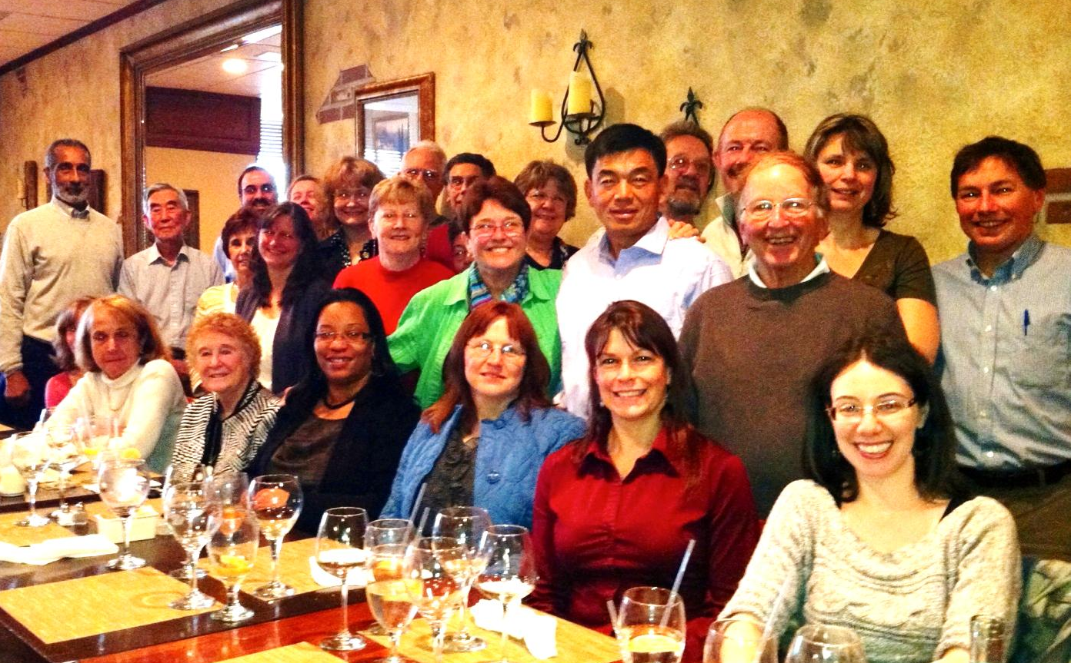
Department of Mathematics and Statistics

Slide 2
Our Department
23 regular full-time faculty
Over 300 Mathematics and Statistics majors
Several Programs –
Mathematics with Specializations in:
Mathematics
Statistics
Applied Mathematics
Mathematics Secondary Education
Mathematics Teaching Elementary or Early Childhood, Deaf & Hard of Hearing, Special Education

Slide 3
Minors (5 Courses)
Mathematics
Statistics
Actuarial Studies
Quantitative Criminology

Slide 4
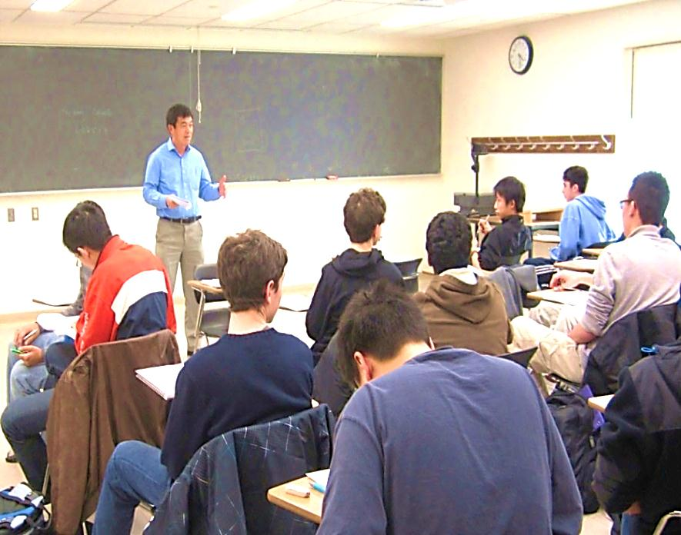
NEED MORE REASONS TO CHOOSE TCNJ?
Small class size
Faculty who are teacher-scholars in their fields
Faculty advisor
MAT 099- Orientation to major

Slide 5
Calculus Placement
Placed into Calculus A with SAT Math score 650 and four years of math including Algebra I, Algebra II, Geometry, Trigonometry
Allowed to register for Calculus but strongly advised to take Precalculus with SAT Math score between 600 and 640 and four years of math
Placed into Precalculus with SAT Math score between 550 and 590
Placed into Intermediate Algebra with SAT Math score below 550

Slide 6
AP Credit
4 or 5 on Calculus AB exam – placed into Calculus B
4 or 5 on Calculus BC exam – placed into Calculus C
3 on Calculus BC exam – placed into Calculus B
4 or 5 on Statistics exam – credit for Statistical Inference

Slide 7

Extracurricular Opportunities
Math & Stat Club
Pi Mu Epsilon
Putnam Exam
Garden State Undergraduate Mathematics Conference
Tutoring

Slide 8

Summer Opportunities
MUSE (Mentored Undergraduate Summer Experience) Program
Research Experiences for Undergraduates
Internships

Slide 9
Sample careers of graduates
Teaching | Grad. School | Companies
Robbinsville High School, NJ | Univ. Texas at Austin (PhD & MS) | Educational Testing Service
Marlboro Middle School, NJ | Rutgers University (PhD) | Prudential Financial (Annuities department)
South Brunswick High School, NJ | Univ. Massachusetts at Amherst (PhD) | Ernst & Young (IT risk area)
Hunterdon School District, NJ | Indiana University (PhD) | Munich Reinsurance (actuarial firm)
Barnegat High School, NJ | UC Davis (PhD) | Mathematica Policy Research
Glen Rock School District, NJ | Univ. Utah (PhD) | NRG Energy (Risk analysis)
Lawrence High School, NJ | Univ. Delaware (MS) | Lockheed Martin
Burlington City High School, NJ | Montclair State (MS), Univ. Memphis (PhD) | Buck Consultants, Secaucus
Westfield High School, NJ | Seton Hall University (JD) | Other actuarial and insurance firms
East Brunswick School District, NJ | University of North Carolina | Government
Moorestown High School, NJ | Law schools! | Pharmaceutical firms

Slide 10
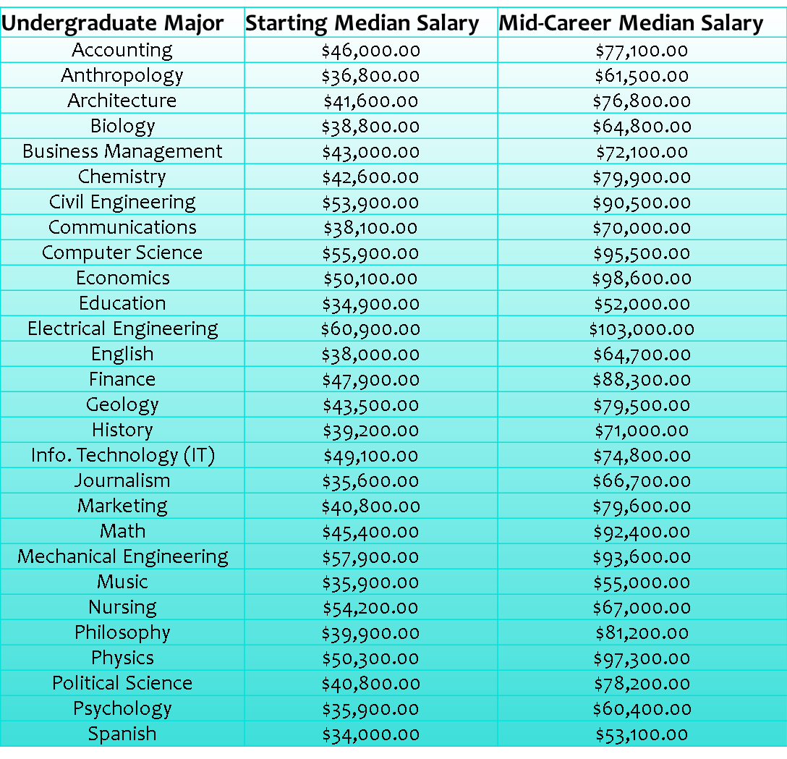
Why Get A Math Degree? Comparison With Other Degrees
MAJOR | Unemployment
Mathematics | 5.0%
Math & Comp | 3.5%
Math Ed. | 3.4%
Actuarial | 0.0%
Statistics | 6.9%
Source: PayScale Inc.
Wall Street Journal, 2010 Census
Rate 9.6% highest year.
Wall Street Journal, from PayScale Inc.
Notes:
My goal here is to introduce you to a list of some of those possibilities and get you to begin thinking about what the field of mathematics has to offer. So that when you leave here you can seek out information and start thinking about what you might want to do when you obtain your degree.

Slide 11
Why Get A Math Degree? Comparison With Other Careers
JOB | SATISFACTION RANKING
Mathematician | 1
Actuary | 2
Statistician | 3
Biologist | 4
Software Engineer | 5
Economist | 11
Physicist | 13
Computer Programmer | 18
Chemist | 57
Electrical Engineer | 62
Civil Engineer | 71
Mechanical Engineer | 74
Attorney | 82
Stockbroker | 84
Senior Corporate Executive | 88
Dentist | 101
General Practice Physician | 142
Jobs Rated.com
200 careers
Notes:
My goal here is to introduce you to a list of some of those possibilities and get you to begin thinking about what the field of mathematics has to offer. So that when you leave here you can seek out information and start thinking about what you might want to do when you obtain your degree.

Slide 12

What Can I Do With A Math Degree? Industries Where Math is Applicable
Computer Industry: Software Design, Computer Programming
Cryptography and Security
Pharmaceutical Industry, Biomedical Industry, Public Health
Investment and Finance
Operations Research/Management Science
Actuarial Science
Notes:
My goal here is to introduce you to a list of some of those possibilities and get you to begin thinking about what the field of mathematics has to offer. So that when you leave here you can seek out information and start thinking about what you might want to do when you obtain your degree.

Slide 13
Most Common Job Title: Analyst
Analyst
Accounting Analyst
Budget Analyst
Business Analyst
Credit Analyst
Cost Analyst
Crypt-analyst
Data Analyst
Financial Analyst
Forensic Analyst
Inventory Analyst
Market Research Analyst
Operations Research Analyst
Rate Analyst
Project Analyst
Program Analyst
Quality Assurance Analyst
Risk Management Analyst
Securities Analyst
http://www.lauriercc.ca/career/students/planning/major/math.htm

Slide 14
For more information on Careers:
http://Weusemath.org
http://www.ams.org/profession/career-info/early-careers/early-careers
http://www.msri.org/ext/CareersInMathematics.html
http://www.beanactuary.org/
http://www.careers-in-business.com/
http://www.careers-in-finance.com/
http://www.amstat.org/Careers/

Slide 15
What Can I Do With A Statistics Degree? Industries Where statistics is used
Manufacturing
Statisticians design experiments and use sampling techniques to improve quality and reliability.
Electrical utilities
Statisticians use time series analysis to forecast demand for electricity and help decide when new power plants are needed.
Market research
Statisticians use sampling techniques and evaluate marketing strategies to determine those most likely to purchase products.
Higher Education
Besides teaching, statisticians in higher education conduct their own research, perform institutional research and consult with researchers from other fields as statistical consultants.

Slide 16
Statisticians in U.S. Government
Bureau of Labor Statistics
Estimate rates of inflation and unemployment which affects interest rates.
Census Bureau
Use sample survey techniques to perform and analyze the Federal census which determines the number of U.S. House Representatives.
Internal Revenue Service
Develop decision rules for auditing returns
Affects whether your tax return is audited
Environmental Protection Agency
Design experiments and analyze data to find if materials damage environment
National Security Agency
Code breaking and enemy military analysis
Department of Agriculture
Use designed experiments to determine which factors maximize the yield of a crop.

Slide 17
Alternate Paths: Pursuing Careers in Law, Business, and Medicine
A study of the LSAT and GMAT scores of college students (the entrance exams for law schools and business schools) show that math majors tend to score much higher than the average.
National Institute of Education, Duke University
Law schools and business schools have taken note of this and welcome math majors into their professions because of their strong analytical and problem solving skills.
The same is true for medical schools. Math majors often have higher acceptance rates to medical school than many of the traditional pre-med majors.
(weusemath.org)
Undergraduate Major | LSAT | GMAT
Mathematics | 12.80% | 13.30%
Philosophy | 8.70% | 11.00%
Chemistry | 7.60% | 7.50%
Biology | 4.00% | 3.30%
English | 5.60% | 4.10%
History | 2.90% | 4.60%
Psychology | 0.90% | 0.80%
Political Science | -1.60% | 0.06%
Business Administration | -4.50% | -0.80%
Notes:
Law schools and business schools have taken note of this and welcome math majors into their professions because of their strong analytical and problem solving skills. The same is true for medical schools. This next chart shows…..

Slide 18
Questions?
Contact
Dr. Cathy Liebars, liebars@tcnj.edu, x3043
Or
Dr. Tom Hagedorn, hagedorn@tcnj.edu, x3053
Co-Chairs, Department of Mathematics and Statistics
Science complex room P231
Our department website:
http://www.tcnj.edu/~mathstat

